Slide 1
Managing New workplace
Week 2

Slide 2
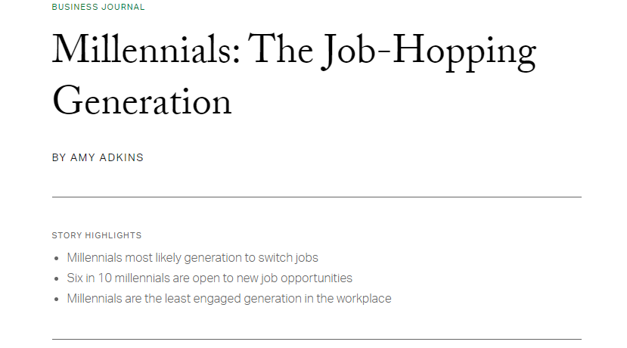
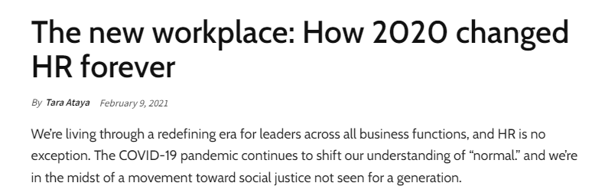

Notes:
https://venturebeat.com/2022/02/16/the-future-of-employee-perks-in-the-post-pandemic-workplace/
https://www.gallup.com/workplace/231587/millennials-job-hopping-generation.aspx
https://hrexecutive.com/the-new-workplace-how-2020-changed-hr-forever/

Slide 3
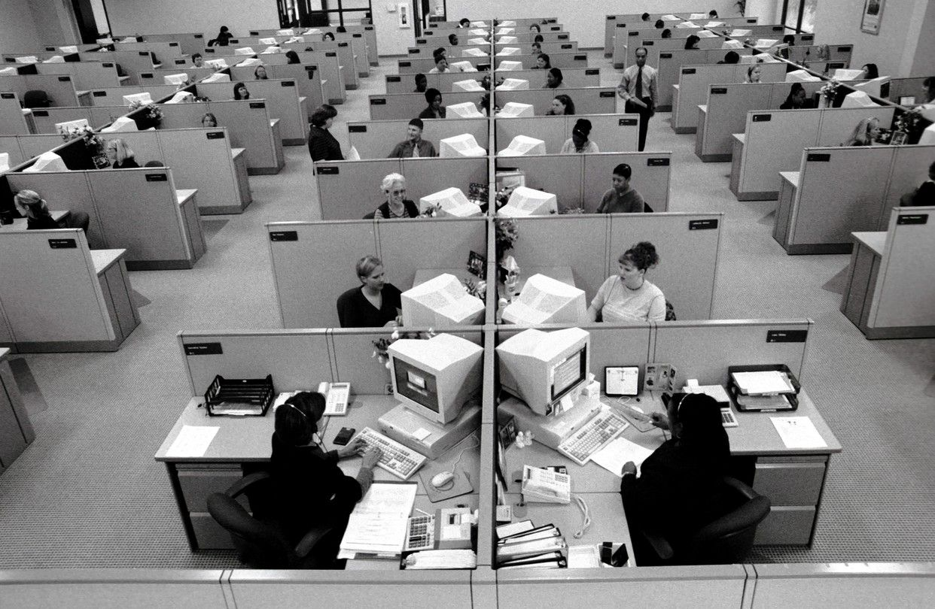
Old workplace (1970s-1990s)
Offices used to be made up of cubicles. Employees were more often encouraged to work independently and stay on focus at all times.
Workplaces were a lot less tech orientated – most business communication took place over landlines and in person and documents were all hard copies.
Email, Word processor and the first personal computers were all invented in the 1970s, however mobiles were not around until 1988 and the internet was not created until 1990.
Notes:
https://theundercoverrecruiter.com/workplace-evolution/

Slide 4
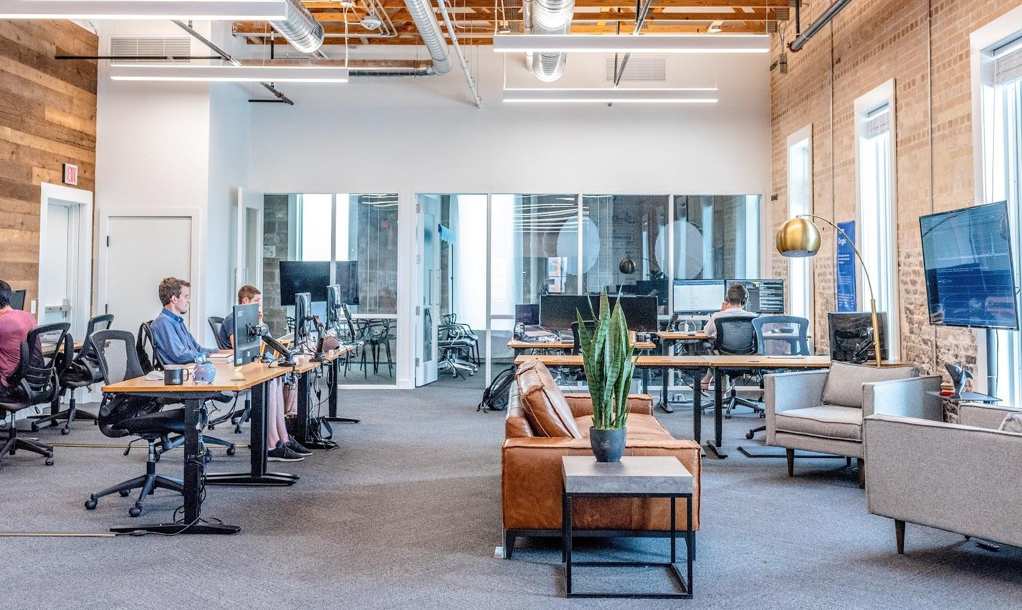
New workplace (2000-today)
There is more focus on feeling comfortable in the workplace, to keep staff happy and motivated.
The modern workplace is all about social collaboration and rising tech trends.
The internet, smart phones, online file sharing, etc. has all made it possible for us to work anywhere and everywhere, which has lead to a rise in remote working and collaborate with people on the other side of the world with ease.
Notes:
https://theundercoverrecruiter.com/workplace-evolution/

Slide 5
Old vs new workplace: comparison of management
Primary Characteristics:
Information and ideas rather than Machines and physical assets.
Shift from an industrial age to an information age has altered nature of work, employees and the workplace

Slide 6
Old vs new workplace: characteristics
 | Old Workplace | New Workplace
Resources | Atoms-Physical assets | Bits-information
Work | Structured, localized | Flexible, virtual
Workers | Dependable employees | Empowered employees, free agents

Slide 7
Old vs new workplace: forces on organizations
 | Old Workplace | New Workplace
Technology | Mechanical | Digital, e-business
Markets | Local, domestic | Global, including internet
Workforce | Homogenous | Diverse
Values | Stability, efficiency | Change, speed
Events | Calm, predictable | Turbulent, more frequent crisis

Slide 8
Old vs new workplace: Management competencies
 | Old Workplace | New Workplace
Leadership | Autocratic | Dispersed, empowering
Focus | Profits | Connection to customers, employees
Doing Work | By individuals | By teams
Relationships | Conflict, competition | Collaboration
Design | Efficient performance | Experimentation, learning organization

Slide 9
Managing small businesses
The environment for small business has become increasingly complicated due to technology, globalization, government regulation and increasing customer demands.
Small companies sometimes have difficulty developing the managerial dexterity needed to survive a complex environment.

Slide 10
Managing small businesses: The role
High:
Spokesperson: promotion of the small growing company
Entrepreneur: creativity required for new idea development
Low:
Leader: focus is on building the business
Information processing: small size and market

Slide 11
Managing not-for-profit organizations
The function of planning, organizing, leading and controlling apply to not-for-profit as they do to business organizations, requiring similar managerial skills
Profit v/s social impact

Slide 12
Managing not-for-profit organizations
Financial Resources: Obtained from government appropriations, grants, and donations rather than from sale of products of services.
Focus: Keeping costs low rather than customer focused sales approach
Performance Measure: intangible outcomes like ‘improvement’ rather than monetary

Slide 13
Managing not-for-profit organizations: The role
High
Spokesperson: selling organization to donors and public
Leader: build a mission driven community of employees and volunteers
Resource allocator: government/grant fund distribution

Slide 14
Crisis management
Organizations face various levels of crisis everyday-everything from loss of computer data to a pandemic.
The world has become fast, interconnected and complex resulting in unexpected events.
“Extraordinary times require extraordinary leadership”

Slide 15
Crisis management: Leadership skills
Crisis management requires five important leadership skills
Stay calm: Leaders have to suppress their own fears, doubts and pain to comfort others
Be visible: People need to feel and see that someone is in control
Put people before business:make people and human feelings a top priority
Tell the truth: Do not block information or investigation
Know when to get back to business : People need something to look forward to, as a sign of hope and rejuvenation

Slide 16
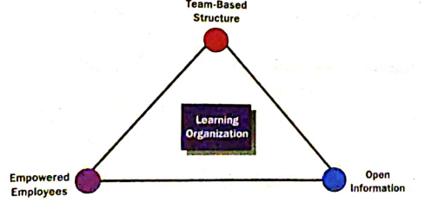
The learning organization
“An organization in which everyone is engaged in identifying and solving problems, enabling the organization to continuously experiment, improve, and increase its capability”
Creating an organizational climate that values experimentation and risk-taking, applies current technology, tolerates mistakes and failure, and rewards nontraditional thinking and the sharing of knowledge.
Everyone in the organization participates in identifying and solving problems, enabling the organization to continuously experiment, improve, and increase its capability.
The role of managers is not to make decisions, bu to create learning capability, where everyone is free to experiment and learn what works best.

Slide 17
The learning organization
The learning organization is an attitude or philosophy about what an organization can become.
Team-Based Structure: People on the team are given the skills, information, tools, motivation, and authority to make decisions central to the team's performance and to respond creatively and flexibly to new challenges or opportunities that arise.
Collaboration, communication, self direction, different skill sets
Empowered Employees: Employees are given freedom, resources, information and skills to make decisions and perform effectively.
self -directed work teams, quality circles, job enrichment, employee participation groups, decision making authority, trunung, and information
Open Information: To identify needs and solve problems, people have to be aware of what’s going on. Open information becomes extraordinarily important in organizations that deal with ideas, rather than material goods.
Formal data on budgets, profits, expenses, information sharing

Slide 18
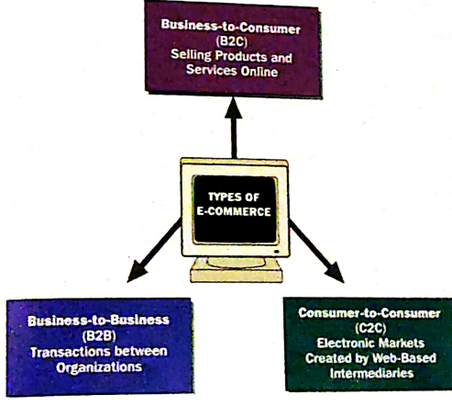
Tech-driven workplace
Ideas, information and relationships are becoming more important than production machinery, physical products and structured jobs.
Shift towards computer based work and virtual teams, machines taking over factories freeing up workers to use their minds rather than efficiencies.
Key Words:
E-Business
Intranet
Extranet
E-Commerce
Enterprise Resource Planning (ERP)
Knowledge Management

